Slide 1
ANTIMICROBIAL
Dr. Haruna Saidy (PharmD)
Senior pharmacist &HoD pharmacy- KGH

Slide 2
Outline
Introduction
Classification of bacteria
Mechanisms and classification antibiotics
Antibiotic for gram positives
Antibiotics for gram negatives
Antibiotics for anaerobes
Antibiotics for atypical
Common side effects and toxicities
Antibiotic resistance

Slide 3
Our learning goals
To have adequate knowledge of the pharmacology of the antibiotics available for variety of infections
To ensure rational use of the chemotherapeutic agents available for various infections
To appreciate the concept of combination therapy and the risk associated with antibiotic misuse

Slide 4
INTRODUCTION
Infection diseases are the commonest afflictions of mankind and are a major source of morbidity and mortality in both developed and developing countries.
Antibiotic therapy should be commenced immediately.
If the organism and its antibiotic sensitivities are unknown, a combination of drugs should be chosen to cover the likely pathogens.

Slide 5
Chemotherapy
Use of chemicals to eradicate parasites, bacteria, viruses or cancer cells from the body
The chemicals are intended to be toxic to the parasitic cells but innocuous for the host.

Slide 6
What do we need to know about these drugs?
Chemical nature & and that of other members of the family
Mechanism of action
Spectrum of activity
Route of administration & pharmacokinetics
Clinical uses (indications)-rational use
Adverse effects
Contra-indications etc.

Slide 7
The concept of selective toxicity
Selective toxicity- Toxicity to the parasite or the unwanted cell but non-toxic to the host (leaves the host or environment relatively unharmed.
Selective toxicity
is the
PIVOT
of
Chemotherapy

Slide 8
How is selective toxicity feasible?
Exploitation of biochemical differences between the parasite and the host cell.
The more closely the unwanted cell or parasite resembles the host the more difficult it is to achieve selective toxicity
The Parasitic cells involved include:
bacteria,
protozoa
helminths
Viruses-utilise the metabolic machinery of the host cell-a problem
Cancer cells-malignant host cells-a problem

Slide 9
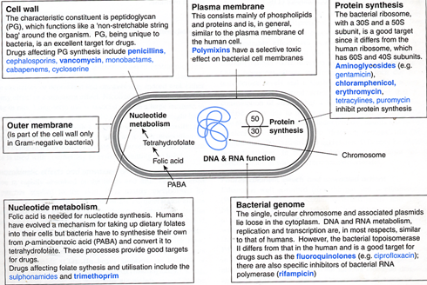
Structural elements and biochemical processes in the bacterial cell as targets for anti-bacterial agents

Slide 10
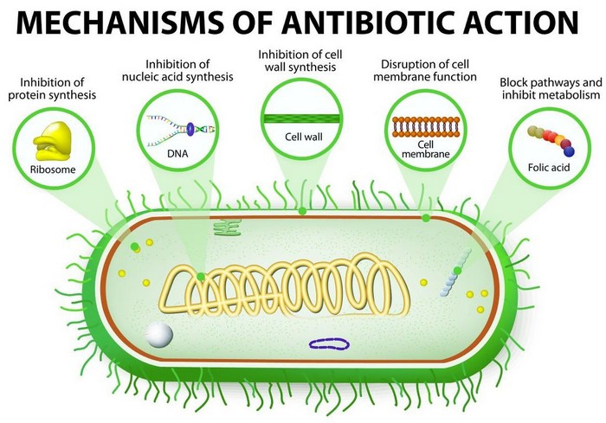

Slide 11
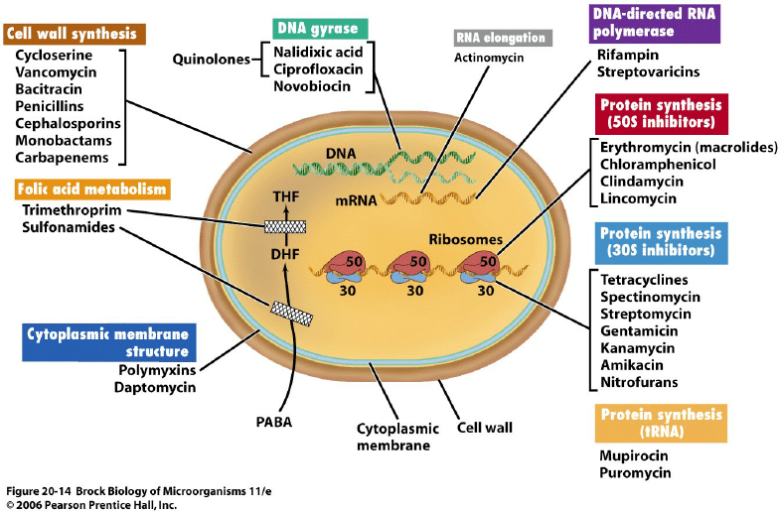

Slide 12
Classification of antibiotics
May be classified in several ways
Chemical structure (β-lactams,
aminoglycosides)
Mechanism of action (inhibitors of cell wall synthesis)
Activity against specific organisms (bacteria, fungi,
viruses)
A combination of mechanism of action
or type of organisms affected by the drug

Slide 13
Sulphonamides
Sulphonamides are synthetic structural analogues of p-aminobenzoic acid e.g. Sulphadiazine, sulphamethoxazole, trimethoprim
Mechanism of Action of sulphonamides
Folate is an essential co-factor in the
synthesis of purines & hence DNA
Bacteria must synthesize folate from
PABA
The pathway is inhibited at 2 points
as shown in the synthetic pathway.
Sulphonamides are bacteriostatic.

Slide 14
Mechanism of action of sulphonamides
PTERIDINE
+
P-AMINOBENZOIC ACID
Dihydropteroate synthetase
Sulphonamides
sulphadiazine
sulphamethoxazole
DIHYDROPTEROIC ACID
cotrimoxazole
DIHYDROFOLIC ACID
PRECURSORS
Trimethoprim
Dihydrofolate reductase
TETRAHYDROFOLIC ACID
DNA
PURINES/PYRIMIDINES

Slide 15
Spectrum of activity/clinical uses of sulphonamides
Simple UTI
Trimethoprim & Co-trimoxazole (trimethoprim & sulphamethoxazole) are used for UTI & RTI
Opthalmic preps of sulphacetamide for bacterial conjuntivitis, sulphasalazine for chronic IBD
Trimethoprim is 20-50x more potent than sulphamethoxazole, suitable for acute UTI & bacterial prostatitis, concentrates in prostrate and vaginal fluids-suitable for infections at these sites
Co-trimoxazole (T+S) has > antimicrobial effect than either. Similar pharmacokinetics.
-Genital infections (acute gonococci urethritis), Chronic bronchitis, GI infections (shigellosis)-succinylsulphathiazole

Slide 16
Adverse effects:
Nausea, vomiting, and hypersensitivity reactions e.g. rashes, fever, crystalluria (nephrotoxicity), haemolytic anaemia in G-6PD patients. Kernicterus in new borns, May potentiate action of tolbutamide or warfarin
Contraindications
Newborns and Infants < 2months
Also pregnant women, possible terratogenic effects

Slide 17
Penicillins and Cephalosporins
Penicillins (anti-bacterial agents) discovered in 1928 by
Sir Alexander Fleming.He, Howard florey and Ernest Boris Chain were awarded the Noble Prize for the discovery of penicillin
Classification of Penicillins
May be classified as:
ß-lactamase sensitive e.g. Penicillin G
ß-lactamase resistant e g. flucloxacillin and methicillin
Broad spectrum eg. Amoxycillin
Antipseudomonas eg. Piperacillin + Tazobactam
OR
Standard penicillins eg. Crystalline penicillin G (I.V), penicillin V (p.o), aqueous procaine penicillin G (i.m), Benzathine penicillin G (i.m)
Anti-staphylococcal penicillins eg.methicillin (I.v), oxacillin,cloxacillin,
Aminopenicillins eg. Ampicillin (i.v, p.o), Amoxycillin (p.o)
Antipseudomonal penicillins eg. Carbenicillin (i.v), Ticarcillin (i.v)

Slide 18
Mechanism of action of penicillins
Penicillins are bactericidal
They bind to penicillin-binding proteins on susceptible microorganisms.
Inhibit the enzyme that inserts the cross-links to the peptide chains (transpeptidation or cross-linkage) required for peptidoglycan synthesis.
The peptide chains are required to attach to the backbone of the peptidoglycan.
This leads to weakening of the cell wall and eventual rupture (autolysis) of the bacterial cell.

Slide 19
Spectrum & pharmacokinetics of β-lactamases sensitive penicillins
Penicillin G:
1st choice for many infections but destroyed by β-lactamases. i.v or i.m, Active against most Gram +ve cocci and Gram –ve bacteria, therefore used for pneumococcal, streptococcal, meningococcal infections. Most s.aureus resistant.
Acid labile? Diffuses widely through body tissues but not into the brain? Excretion mainly renal, probenecid may be used to improve plasma concentration. Phenoxymethylpenicillin (Penicillin V) given orally but less potent.
Two repository forms of Pen G for i.m use
Aqueous Procaine penicillin G: Procaine delays the absorption of penicillin leading to high therapeutic concentrations.
Benzathine Pen G: Pen G + an ammonium base, sustained plasma concentrations for the treatment of syphilis.

Slide 20
β-lactamase resistant penicillins eg. Flucloxacillin and methicillin
Spectrum of activity similar to pen V but less potent.
Absorption better than Pen G. Mainly for infections with organisms which produce β-lactamase . Many staphylococci now resistant eg MRSA.
Broad spectrum
Absorption very good.
Spectrum broader than Penicillin G, May be destroyed by β-lactamases. Combined with clavulanic acid . Oral, i.m or i.v
Active against Gram +ve and –ve bacteria including E. coli,
H.influenza.
Antipseudomonas:
Susceptible to β-lactamases. Spectrum similar to broad spectrum + pseudomonas. Poorly absorbed, given by i.v or deep i.m. Ticarcillin is also effective against Gram –ve organisms e g. Proteus, may be combined with clavulanic acid.

Slide 21
Clinical uses of the penicillins
1st choice drugs for many infections, bacterial meningitis and infections of bone , joints, skin and soft tissues, throat, bronchi and urinary tract.
Gonorrhoea and syphillis
Possible resistance.
Side effects of penicillins
Hypersensitivity
Diarrhoea
Nephritis especially methicillin
Neurotoxicity if given intrathecally
Platelet dysfunction, carbenicillin and ticarcillin
Cationic toxicity

Slide 22
Cephalosporins
1st cephalosporin discovered by Guiseppe Bortzu in 1945
Consist of: ß-lactam ring fused to a six membered S-contaning dihydrothiazine ring.
Classified as:
1st generation eg. Cephalexin,cephadroxil (oral), cephradine (parenteral)
2nd generation eg.cefuroxime (oral), cefamandole (parenteral)
3rd generation eg. cefixime (oral), cefotaxime (parenteral)
Based on their spectrum against aerobic Gram –ve bacilli.  1-3
Antistaphylococci action decreases from  1-3
4th generation eg. cefepime
Mechanism of action
Bactericidal, ß-lactam therefore similar action to the penicillins.
The dihydrothiazine ring confers a degree of ß-lactamase resistance.

Slide 23
Spectrum of activity of cephalosporins
1st-useful for skin and soft tissue infections, against streptococci,staph, E.coli, P mirabilis and K pneumoniae. Infections against surgical procedures
2nd a) activity against H. influenzae eg. cefaclor, cefamandole
b) against B.fragilis eg. cefoxitin, cefmetazole
For empirical treatment of respiratory infections due to S. pneumoniae (sinusitis, otitis media, pneumonia), also for infections in children.
For mixed aerobic infections and soft tissue infections eg in diabetic patients.
3rd –increased activity against aerobic Gram –ve bacteria eg. Enterobacteriaceae and H influenzae
Some are effective against P.aeruginosa e.g. ceftazidime

Slide 24
Spectrum (contd)
Unlike penicillins not active against enterococci.
Only 10% cross allergenity, may be used in patients allergic to the pens.
Note that the cephalosporins can be inactivated by B-lactamase enzyme, 3rd generation more resistant.
Clinical uses of cephalosporins
2nd choice for many infections such as septicaemia, meningitis, pneumonia, biliary tract and urinary tract infections caused by susceptible organisms.

Slide 25
Glycopeptides e.g vancomycin
Bactericidal, inhibit peptidoglycan synthesis
Active only against aerobic and anaerobic Gram +ve bacteria.
Used for septicaemia caused by MRSA
Drug of choice (oral) for antibiotic associated pseudomembranous colitis (Super infection of the bowel by clostridium difficile, which produces a toxin that damages the colonic mucosa.
Given mainly by parenteral unless a local action is required.
May cause ototoxicity and nephrotoxicity at high plasma concentrations, also fever and rashes.

Slide 26
The aminoglycosides
e.g. gentamycin, streptomycin, neomycin, amikacin
Consist of two or more amino sugars linked by glycosidic bonds to an aminocyclitol ring.
Mechanism of action
Belong to a group of antibacterial agents that interfere with protein synthesis. They bind irreversibly to the bacterial ribosome inhibiting the translation of mRNA to protein.
Also cause more frequent misreading of the prokaryotic genetic code.

Slide 27
Spectrum of activity
Broad antibacterial spectrum of activity.
But relatively low activity against anaerobes, since anaerobes lack the oxygen requiring transport system.
Streptococci and pneumococci.
Streptomycin is used against Mycobacterium tuberclosis
Gentamycin used for Enterobacteriaceae, P.aeruginosa and enterococci infections
The aminoglycosides synergize with B-lactam
antibiotics since B-lactams action enhances the diffusion of aminoglycosides in the bacterium.
Route of administration-pareteral only due to poor absorption.

Slide 28
Adverse effects of aminoglycosides
Dose and duration-dependent ototoxicity and nephrotoxicity
Ototoxicity can be permanent.
Due to toxicity and parenteral administration, reserved for serious infections due to Enterobacteriaceae and P. aeruginosa.
Possibility of neuromuscular paralysis following i.p in large doses. Administration of calcium gluconate or neostigmine.
Allergic contact dermatitis, common reaction to topically applied neomycin.

Slide 29
Macrolides
Erythromycin, clarithromycin and azithromycin
Mechanism of action
Bacteriostatic or bactericidal
Bind reversibly to a site on the 50S subunit of the bacterial ribosome, preventing the translocation movement of the ribosome along mRNA.

Slide 30
Spectrum of activity
Erythromycin, similar spectrum to penicillin G,
May be used in patients allergic to the penicillins.
Active against most Gram +ve bacteria and spirochaetes and infections caused by staphylococci, pneumococci and clostridia.
Clarithromycin, similar to erythromycin, also effective
against H.influenzae and Helicobacter pylori. Has high activity against Chlamydia & Legionella than erythromycin.
Azithromycin, less active against Staph and strept than erythromycin, but more effective against respiratory infections due to H.influenzae. Also preferred drug for urethritis caused by Chlamydia trachomatis.

Slide 31
Route of administration
Oral or i.v
Adverse effects
GI disturbance, cholestatic jaundice (estolate form) probably due to a hypersensitivity reaction. Reversible ototoxicity at high
doses.
Pharmacokinetics
Erythromycin base unstable in gastric acid, E.C or esterified forms administered. Oral absorption good for all. Clarithromycin and azithromycin are stable to acid, readily absorbed,
Food interferes with absorbtion of erythromycin and azithromycin but can improve absorption of clarithromycin.
Erythromycin distributes adequately in all body fluids except CSF.
Extensively metabolised and inhibits the P450 system, inhibits oxidation of a number of drugs eg warfarin, astemizole.
Clarithromycin oxidized to the 14-hydroxy, which retains activity
Interferes with metabolism of theophylline and carbamazepine.
Azithromycin & erythromycin excreted into bile and clarithromycin by the kidney.

Slide 32
Contraindications
Patients with hepatic dysfunction should not be treated with erythromycin due to accumulation in the liver.

Slide 33
Tetracyclines
Tetracycline, minocycline, doxycycline
Mechanism of action.
Tetracyclines are bacteriostatic
Selective uptake into bacterial cells by a selective bacterial transport system
Binds reversibly to the bacterial ribosome.
Interfere with attachment of tRNA to the mRNA ribosome complex.

Slide 34
Spectrum of activity
Broad spectrum against Gram +ve/ –ve bacteria, intracellular
pathogens eg. Chlamydia (non-specific urethritis, trachoma etc). Also for
Rickettsial and mycoplasma infections.
Pharmacokinetics
Adequately absorbed orally but incompletely after oral administration.
Absorption affected further by taking with dairy products due to formation
of non-absorbable chelates with calcium.
Not taken with iron preps or with antacids.
Tetracyclines concentrate in the liver, kidney, spleen and skin and tissues
undergoing calcification eg. teeth and bones or tumours with high
calcium content (gastric carcinoma)
Enter the CSF in insufficient quantities for therapeutic efficacy except
Minocycline, which appears in saliva and tears.
Minocycline is effective against the carrier state of meningococcal
infections but not CNS infections.
All tetracyclines cross the placental barrier and enter fetal bones and dentition.
Contraindicated in children and pregnant women.

Slide 35
Pharmacokinetics (continued)
Metabolised in liver to form glucuronides and secreted into bile
or GF following enterohepatic circulation. Doxycycline excreted
into bile, may be used for infections in renally compromised patients.
Adverse effects of tetracyclines
Gastric discomfort due to irritation of the gastric mucosa
Discolouration of teeth due to deposition
in bone and primary dentition.
Possible hepatotoxicity in pregnant women receiving high
doses of tetracycline.
Phototoxicity eg. severe sunburn
Vestibular disturbances (dizziness, nausea, vomiting) esp.
minocycline
Superinfections eg. Candida

Slide 36
Chloramphenicol
Mechanism of action
Both bactericidal and bacteriostatic depending on the bacterial species
It reversibly binds to the bacterial ribosome, inhibiting the formation
of peptide bonds.
Spectrum of activity
Active against a wide range of Gram +ve and Gram-ve
bacteria. It is however reserved for life-threatening infections , especially
typhoid fever and meningitis.
Pharmacokinetics
Administered, iv or oral.
Highly lipophilic therefore completely absorbed after oral administration.
Inhibits the MFO system, metabolised in the liver to a glucuronide
followed by excretion in the urine. Only 10% excreted unchanged.

Slide 37
Adverse Effects
Limits the use of Chloramphenicol.
Includes gastrointestinal upsets and overgrowth of candida
in the mucous membranes
Anaemia, haemolytic anaemia especially in pateints with G6PD
deficiency.
Also reversible anaemia and aplastic anaemia (idosyncratic)
Grey syndrome, High levels of drug in babies leads
to poor feeding, depressed breathing, cardiovascular collapse
cyanosis and death.
Interactions: inhibition of liver enzymes, reduced metabolism of phenytoin, tolbutamide, warfarin.
Periodic blood counts are required when the drug is given in high doses to patients with renal failure or neonates.

Slide 38
Clindamycin
Interferes with protein synthesis
Acts against many penicillin-resistant Staph and
some anaerobes eg. Bacteroides
Use can lead to pseudomembranous colitis.

Slide 39
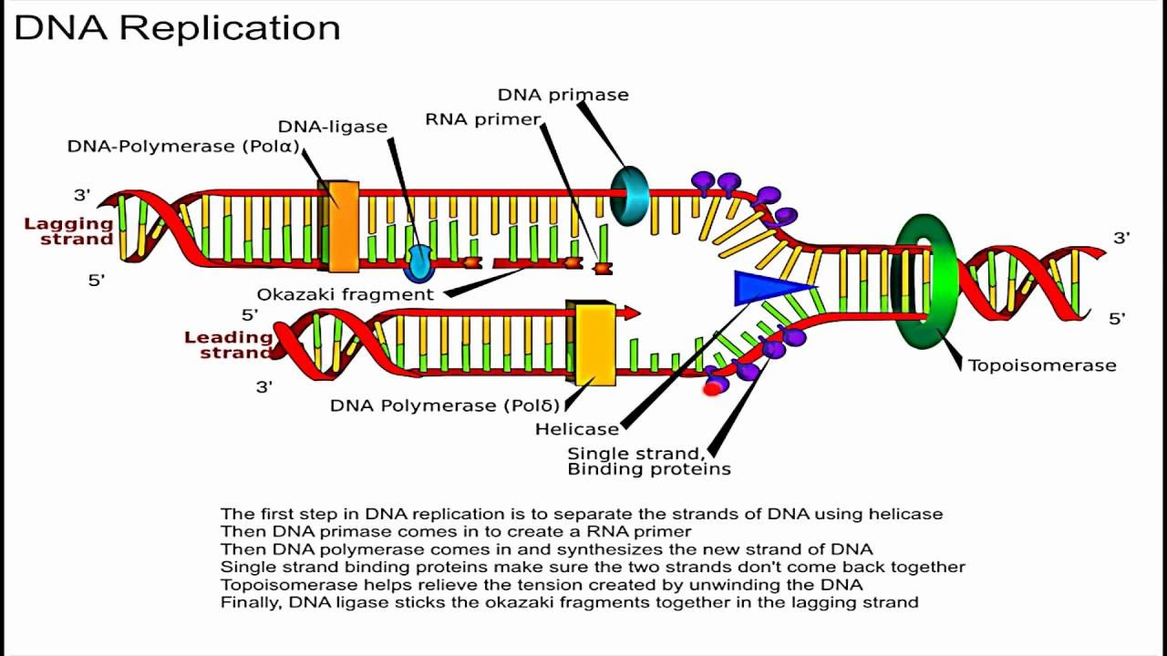
QUINOLONES

Slide 40
Quinolones & Fluoroquinolones (Drugs affecting DNA synthesis)
Examples: Nalidixic acid (non-fluorinated quinolone), norfloxacin, ciprofloxacin,
ofloxacin.
Mechanism of action
They are bactericidal.
They inhibit topoisomerase II (DNA gyrase), the enzyme that packages DNA into supercoils and is essential for DNA transcription, replication and repair.
Spectrum of activity
Effective against Gram-ve bacteria such as Enterobacteriaceae, pseudomonas and H influenzae.
Pharmacokinetics
I.V or Oral. Only 35-70% of oral norfloxacin is absorbed compared to 70-90% of others. Ciprofloxacin is well absorbed but absorption is affected by co-administration with antacids, dietary supplements containing zinc or iron.

Slide 41
Clinical uses
Complicated UTI, gonorrhoea, cervicitis,prostitis
Thyphoid fever, septicaemia, respiratory infections not due to
Pneumococci.
Adverse Effects of fluoroquinolones
GI disturbances,
CNS effects eg. Nausea, headache, lightheadedness,
Nephrotoxicity-possible crystalluria,
phototoxicity
Inhibits the metabolism of theophylline, warfarin caffeine and
Cyclosporin.
Cimetidine interferes with the elimination of the fluoroquinolones

Slide 42
Miscellaneous anti-bacterial agents
Metronidazole
Nitrofurantoin
Bacitracin
Polymyxins
Metronidazole & tinidazole
Metronidazole is bactericidal.
It is metabolized into an intermediate that inhibits bacterial DNA synthesis and degrades existing DNA.
It is selectively toxic because the intermediate toxic metabolite is not produced in mammalian cells.
Metronidazole is anti-protozoal but it has antibacterial activity against anaerobic bacteria.
Oral, rectal, i.v, topical
Should not be given to pregnant women
Adverse effects: Mild headache and GI disturbances, Adverse reactions occur with alcohol.

Slide 43
Nitrofurantoin
Mechanism not fully elucidated but possibly interferes with bacterial DNA metabolism
Active against Gram+ve bacteria and E. coli
Given orally and attains high therapeutic concentration in the urine.
Causes GI disturbance, but pulmonary complications can occur with chronic administration.
Bacitracin
A natural antibiotic from Bacillus subtilis
Inhibits cell wall formation
Spectrum of activity similar to the penicillins
Well tolerated when used topically but serious nephrotoxicity can occur if used systemically.
Less likely to cause hypersensitivity compared to the pens.

Slide 44
Polymyxins
E.g. Colistin, less prescribed due to toxicity
Bactericidal, interact with phospholipids on the outer
plasma membranes of Gram –ve bacteria, disturbs the
bacterial osmotic pressure leading to lysis
Active only against Gram –ve bacteria including P. aeruginosa
I.V, i.m or inhalation. Oral given to sterilize the bowel in neutropenic
patients.
Adverse effects include, vertigo, neurotoxicity, nephrotoxicity.

Slide 45
Selecting antibiotic therapy
Antibiotics can be used prophylactically or therapeutically.
Factors to be considered during selection include:
Bacterial
Host
Drug
Bacterial factors
Antibacterial therapy initiated for bacterial infections only.
Identifying the causative organism
  Reasonable guess based on statistical probabilities eg. UTI in sexually active premenopausal women is due to E.coli in 85% cases
  Cellulitis of arm or leg due to Strept pyogenes or Staph aureus
  The following will help in making a good guess:
  Site of infection
  Community or hospital aquired
  Age, underlying illness, and predisposing factors of the host

Slide 46
Host factors
Site of infection
Allergy
Renal & hepatic function
Concommitant medications
Age
Route of administration
Drug factors
Activity against the parasite
Available route of administration
Adverse effects profile
Dosing frequency
Compliance factors including taste for children medication
and the cost of treatment

Slide 47
ANTIBIOTIC STEWARDSHIP
Antibiotic stewardship promotes the optimal use of antimicrobial agents to reduce the emergence of resistant pathogens, improve the quality of patient care and safety, and reduce costs. Optimal use of antimicrobial agents includes appropriate selection, dose, route, and duration of therapy.

Slide 48
Conclusion on Antimicrobial chemotherapy
Widespread and often inappropriate use of antibiotics has led to increasing number of organisms with multiple drugs resistance.
Antibiotics are not required for all infections or intestinal bacterial infections the majority of which are self limiting conditions.
Nevertheless, in many countries of the world antibiotics are readily available over the counter and are often used in inadequate amounts and for the wrong diseases.

Slide 49
Although the majority of antibiotics are relatively safe drugs, important toxic effects do occur when used in the incorrect dosage and in the presence of other diseases states, notably renal diseases.
In addition antibacterial therapy may result in secondary yeast or fungal infection or may facilitate the growth of a second bacterial pathogen, such as clostridium difficile, an important cause of antibiotic associated colitis.
Thus it is essential that a number of factors should be taken into account before commencing and during antimicrobial chemotherapy.

Slide 50
Choice of drugs
Bling therapy. In the majority of clinical situations antimicrobial therapy is begun before the organism is identified and its antibiotic sensitivities known. The choice of drugs is therefore dependent on a clinical diagnosis and a knowledge of the organsims likely to be involved in a given situation. Before beginning blind therapy it is essential to obtain appropriate body fluids or other specimens for microbiological examination. Adjustment to the antibiotic regimen can the be made, if necessary, when antibiotic sensitivities are available.
Spectrum of activity. The spectrum of antibacterial activity of the drug chosen should ideally be as narrow as possible, as it will then have fewer detrimental effects on the normal bacterial flora the host. Blind therapy, however by necessity generally covers a broader spectrum than required.
Bactericidal vs bacteriostatic. In the majority of infections there is no firm evidence that bactericidal drugs [penicillins, cephalosporins, aminoglycosides] are more effective than bacteriostatic drugs, but it is generally considered important to use the former in the treatment of bacterial endocarditis and in patients in whom host defence mechanisms are compromised.

Slide 51
Patient factors.
In addition to age and pregnancy, the following factors should be consider.
The site of infection. The chosen drug must be able to gain access to the part of the body involved. The brain, eye, biliary tract, prostate and loculated abscesses are inaccessible to many drugs.
Renal and hepatic function. Impaired renal or hepatic function necessitates a major modification of the dose regimen or even complete avoidance of certain drugs. Care should be taken when using aminoglycosides, carbenicillin, ticarcillin, flucytosine and some antituberculous agents in patient with renal impairment. Other drugs, such as nalidixic acid, tetracycline and vancomycin , should be avoided altogether.

Slide 52
Dose
The dose of drugs used is influenced by the type of infection to be treated and the age of the patient. [eg brain or lung] generally require high dose therapy for several weeks, generally beginning with intravenous administration of drugs. Dosage of individual drugs are given under the description of each diseases.

Slide 53
ROUTE OF ADMISTRATION
Some drugs [e.g some of the cephalosporins] are only available as intravenous preparations but many antibiotics are well absorbed by the oral route and generally there is no advantage to the patient for therapy to be admistered by the more expensive parenteral route. Patient compliance must, however, to be taken in to account.

Slide 54
DURATION OF THERAPY
For some infections the arbitrary 7/10 days treatment has now been dramatically reduced, as there is now good evidence that a 3 day course of antibiotics is quite sufficient to treat many lower urinary tract infections.

Slide 55
MONITORING
In serious infection [eg subacute bacterial endocarditis] monitoring of circulating drugs concentrations is important for assessing efficacy of treatment.
Drugs concentrations can be measured directly in serum, but the efficacy of the therapy is best determined by serum bactericidal assay just before and at a standard time after administration of antibiotics.
The highest dilution of serum that completely kills the causative organism can then be determined. Monitoring for toxicity is particularly important with the aminoglycoside antibiotics. Concentrations are determined immediately before [trough levels] and usually 15/30 minutes after intravenous administration of the drug. Higth trough levels of 2ug;ml are considered to be the most important factor in causing the oto and nephrotoxicity commonly seen with these agents.

Slide 56
COMBINATION ANTIBIOTIC THERAPY
Combinations of antibiotics are commonly used in the empirical treatment of many serious infections such as septicaemia, meaningitis, tuberculosis and endocarditis, but some care must be taken in the choice of drugs within such combination of a bacteriacidal and a bacteriostatic antibiotic may impair their therapeutic efficacy. However, this concept is by no means universally applicable since the bacteriostatic drug tetracycline and the bactericidal drug rifampicin are thought to be synergistic. Generally, combinations of bacteriostatic drugs are generally only additive.

